Slide 1

Mrs. Thomas’s Class
Classroom Newsletter
January 7, 2019
Dates to Remember
1/11 – Club Day; End of Semester
1/18 – No School; Teacher Work Day
1/21 – No School; MLK Day
1/24 – Report Cards Go Home; Parent Night
1/29 – 100th Day of School
2/1 – Math Facts Fluency Logs Due
Math Homework
Students will receive miscellaneous worksheets as homework this week on even & odds & skip counting. The pages will not come from the workbook as usual. This way you can identify your child’s homework.
Math homework is due the next day.
Classroom News
Happy New Year and welcome back! I hope you had a wonderful and relaxing winter break.
We will have a quiet day on Monday, January 7th as we review & practice classroom & school rules & procedures. Students will write about their winter break, finish up a few minor things leftover from before the holidays, get their new spelling words, learn about New Years, and make a New Year resolution. On Tuesday, we will start a new unit in reading, writing, science, and social studies. In math, students will learn about even & odds and practice counting by 2’s, 5’s, & 10’s. Students will have a quiz in math on Thursday on these concepts. We will start our next unit in math, Chapter 5 – Place Value, on Friday, January 11th.
Students will write their spelling words on index cards and mark them up in class on Monday, January 7th. Spelling homework is due as usual on Friday, January 11th. Students will receive their reading log as well on Monday. Reading for the
week will be from Monday – Thursday
(1/7 – 1/10) & turned in on Friday, 1/11.
Please cut, sign, & return Newsletter dated 1/7/19
________________________ ____________________________
Child’s Name Parent’s Name
©Ashley Magee, First Grade Brain graphics © Thistle Girl Designs, Little Red, Pink Cat Studio

Slide 2
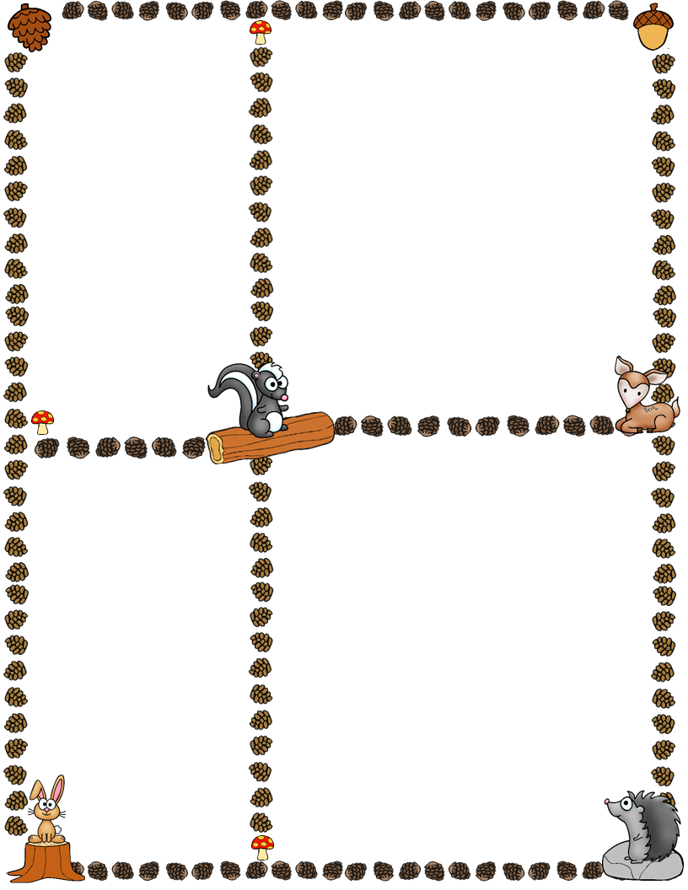
Spelling Words
Focus: ai & ay
Rule: When two vowels go walking, the first one does the talking, the second does the walking.
1) rain 6) hay
2) chain 7) gray
3) stain 8) stay
4) nail 9) clay
5) pain 10) day
January Goals:
Math Timed Fluency: 6
Correct (add/sub)
Reading Timed Fluency:
30 words per minute
Hiker of the Week
Starting Monday, January
14th, first grade will have a
Hiker of the Week each
week until the end of
school. A student will be
randomly chosen &
announced in the
newsletter each Friday so
that child can prepare for
their upcoming week.
Here are the perks as Hiker
of the Week:
Line Leader
Morning Greeter
Yoga Helper (1-2X’s)
3 Pictures to Share
Hiker of the Week Sheet
1 Show-n-Tell item
What We’re Learning Next Week
Reading: Story Structure (characters, setting, plot
Spelling/Phonics: ai & ay
Writing: Informational
Math: Place Value
Science: Sun & Stars
Social Studies: Our Past, Our Present
Before winter break, students chose new classroom jobs which they will start today. Students will keep their classroom job they picked until the end of the year. Ask your child what his/her classroom job is.
Students also chose which club they wanted to participate in. Clubs will meet for the first time this Friday, 1/11 and will be held from 12:45 – 1:45. Ask your child what club he/she chose.
Cooking with kids for our next parent night is on Thursday, January 24th from 10:00-11:00. This is a great way to get classroom hours if needed! Help is always needed! Please sign up on SignUp Genius.
©Ashley Magee, First Grade Brain graphics © Thistle Girl Designs, Little Red, Pink Cat Studio

