Slide 1
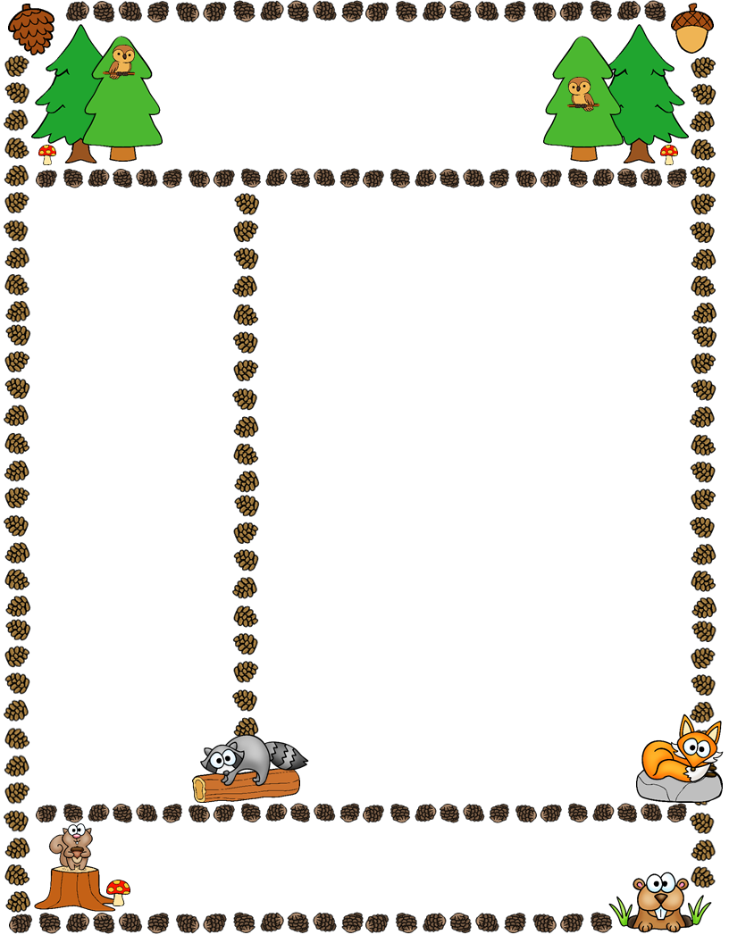
Mrs. Thomas’s Class
First Grade Newsletter
October 13, 2017
Dates to Remember
10/16 – Phonics Workshop @ 8:00 a.m.
10/16 – 1st Grade Conferences
10/17 – End of 1st Nine Weeks
10/20 – Teacher Workday – No students
10/24 – Picture Day
10/26 – Parent Night
10/27 – Report Cards Go Home
10/31 – Pumpkin Day
Classroom News
Our test on subtraction concepts will be on Wednesday, October 18th. A test review will come home on Monday, October 16th as homework and will be due the next day. We will go over the test review in class on Tuesday, work on any final misconceptions, & test on Wednesday. Please remember to study subtraction & addition vocabulary words.
Pumpkin Day at HLA is on Tuesday, October 31st. We are in need of a lot of volunteers for this event. Please sign up through Sign Up Genius under “HLA School Wide Volunteer Activities.” Parents can only sign up for one two hour spot and only one person per family can sign up.
Student Reading Achievement (SRA) started this week. Please e-mail me if you are interested in volunteering to read with children and we can set up a day and time for you to come in. You did not have to attend the workshop in order to read with students.
Hiker of the Week
Our hiker for this week is Azzozi Almarshoud! Don’t forget to fill out your “Hiker of the Week” sheet and bring one item for Show and Tell. You may also send in some photos to display on our board if you wish!
Please cut, sign, and return Newsletter dated 10/13/17
______________________ ________________________
Child’s Name Parent’s Name
©Ashley Magee, First Grade Brain graphics © Thistle Girl Designs, Little Red, Pink Cat Studio

Slide 2
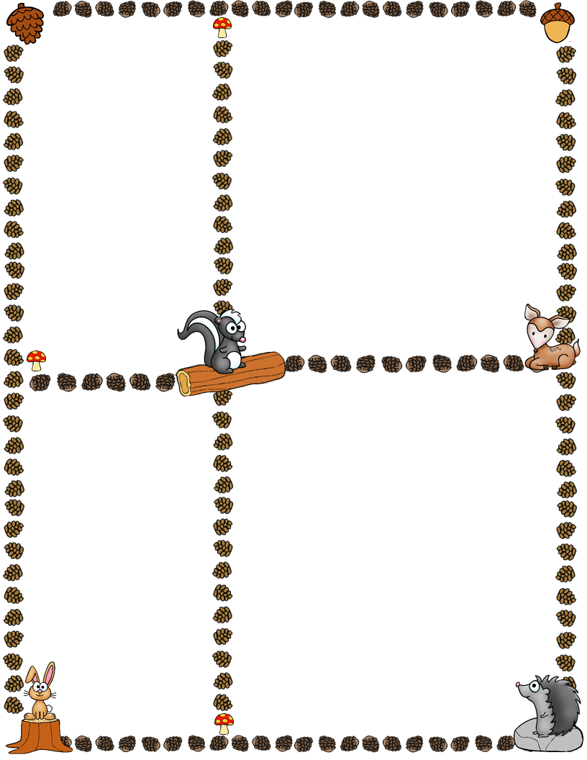
Spelling Words
Focus: short /a/ & /e/; closed syllables
Rule: Closed syllables end with a consonant which guard the vowel to make the short sound.
Hedgehogs:
1) shed 6) stem
2) rash 7) clasp
3) pack 8) best
4) bath 9) then
5) lamp 10) nest
Bears:
craft 6) blessing
faster 7) dresser
blast 8) resting
sand 9) lending
better 10) helping
What We’re Learning Next Week
Reading: Sequence of Events
Spelling/Phonics: short /a / & /e/
Writing: Sentences
Math: Addition Strategies to 20
Social Studies: Leaders
Homework
I am trying really hard to have children put their homework that they need to complete in the LEFT pocket of the purple folder so it doesn’t get mixed in with all the other papers that go home.
Book It!
Coupons went home on 10/19 for the month of September. Please look in your child’s pencil pouch for the coupon. We will continue Book It! each month. The goal for October is 330 minutes! If your child reads for 15 minutes 5 nights a week, he/she will make the reading goal for October.
Math Facts
Keep practicing those math facts and log the time!
Word of the Week
Community
School Days
Please be sure to ask your child about the following activities from this past week: Columbus Day, Types of Storms, Related Facts, Comparing, and Math Stations.
Index Cards
An extra set of index cards went home on 10/9 to keep at home (again) since I I had forgotten to give the kids their index cards
last Friday.
©Ashley Magee, First Grade Brain graphics © Thistle Girl Designs, Little Red, Pink Cat Studio

